Slide 1
SegLungAI
Neonatal Lung Segmentation Using AI

Slide 2
Team Members & Advisor
Dhyey Patel Email: patel4du@mail.uc.edu
Advisor: Dr. Jason Woods, PhD Department Head, CPIR, CCHMC Professor, UC Department of Pediatrics
Collaborators: Alex Matheson, PhD Research Fellow, CPIR, CCHMC Abdullah Bdaiwi, PhD Research Fellow, CPIR, CCHMC

Slide 3

Introduction and Background
Problem Statement:
Neonatal lung segmentation is challenging due to limited data, anatomical variability, and imaging artifacts.
Clinical Relevance:
Accurate lung segmentation aids early diagnosis of neonatal diseases (e.g., bronchopulmonary dysplasia).
Motivation:
Automating segmentation significantly reduces radiologist workload and accelerates clinical decision-making.

Slide 4
Project Abstract
Purpose: Develop a machine learning model to automatically segment lung regions in neonatal MRI scans.
Technique: Leverages semantic segmentation with a ResNet-50 backbone for high accuracy.
Challenges Addressed: Tackles unique issues in neonatal imaging (e.g., small anatomy, image variability).
Resources: Utilizes open-source tools and institutional resources for scalability and efficiency.
Collaboration: Incorporates feedback from medical professionals to align with clinical needs.
Impact: Streamlines diagnostic workflows and improves precision in detecting lung anomalies.

Slide 5
Project Goal
Develop a supervised deep learning model specifically for neonatal lung segmentation in MRI scans.
Primary Objectives:
Achieve high segmentation accuracy.
Minimize manual intervention.
Enable scalability and reproducibility in clinical settings.

Slide 6
Method
Data Collection & Preprocessing:
Initial dataset: 13 neonatal MRI scans (due to ethical and logistical challenges).
Image reorientation to standard orientation and voxel size normalization (1 mm³).
Extensive data augmentation to compensate for limited dataset:
Model Architecture:
Customized U-Net architecture with ResNet-50 backbone (pre-trained on ImageNet).
Encoder-decoder structure with skip connections for multi-scale feature extraction.
Sigmoid activation for pixel-level segmentation probability.
Rotations ±15°, translations ±5%, zoom ±15%, horizontal flips.

Slide 7
Training and Evaluation
Training Strategy:
Loss Function: Combined Dice Loss + Weighted Binary Cross Entropy (BCE).
Optimizer: Adam (learning rate: 1e-4).
Techniques: Early stopping, ReduceLROnPlateau scheduler.
Evaluation Metrics:
Dice coefficient (primary metric).
Intersection over Union (IoU), ROC AUC.
Robust validation strategy: 70% training, 20% validation, 10% test split.

Slide 8
Results
Segmentation Performance:
Mean Dice Score: ~0.90 on validation.
IoU range: ~0.83–0.85.
ROC AUC: 0.999 (highly accurate separation of lung vs. background).

Slide 9
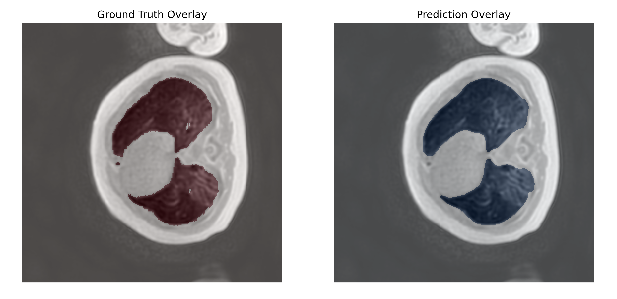
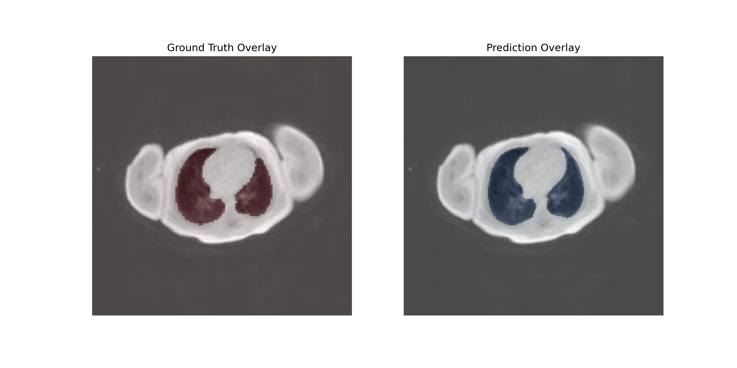
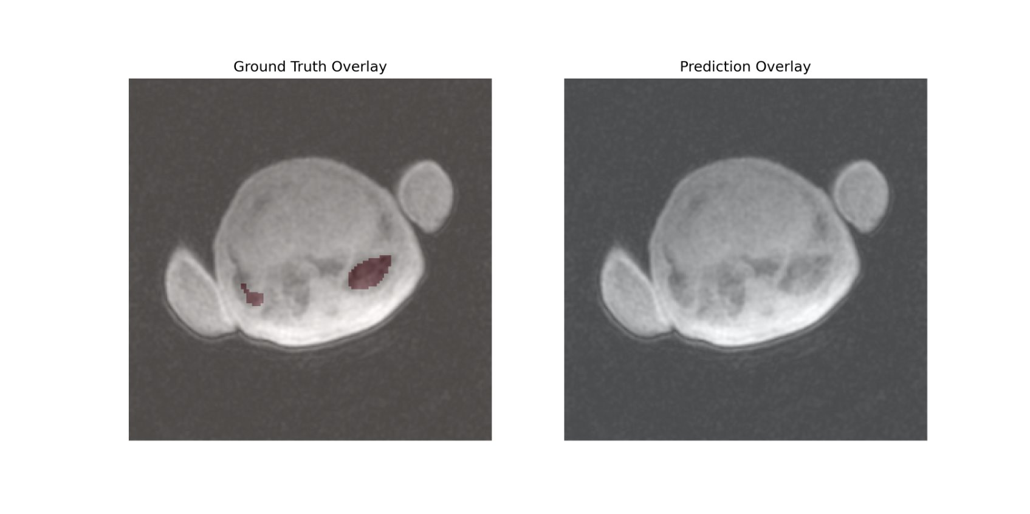
Comparison plots

Slide 10
Major Project Constraints
Economic:
Limited to open-source tools and institutional resources.
Professional:
Requires expertise in semantic segmentation and medical imaging.
Ethical:
Ensure patient data anonymity and secure storage.
Legal:
Compliance with HIPAA and intellectual property regulations.

Slide 11
Limitations and Challenges
Limited Dataset:
Only 13 neonatal scans initially available, impacting generalizability.
Slice-wise Processing:
2D segmentation ignores 3D spatial context, possibly leading to inconsistent segmentation between slices.
Annotation Inaccuracies:
Manual ground truth annotations occasionally inaccurate or inconsistent.
Sensitivity to Artifacts:
Model sensitive to motion artifacts and presence of medical equipment.

Slide 12
Future Work
Dataset Expansion:
Collaborate with other centers to acquire larger neonatal datasets.
nnU-Net Implementation:
Integrate nnU-Net framework for optimized segmentation performance tailored to neonatal MRI scans, leveraging automated hyperparameter tuning and preprocessing optimizations.
Advanced Post-processing:
Apply morphological filtering and anatomical constraints to improve predictions.
External Validation:
Validate model performance on external datasets.
User Interface Development:
Create clinician-focused software to facilitate adoption in clinical workflows.

Slide 13
Project Impact & Conclusion
Clinical Impact:
Automates a previously tedious manual segmentation task.
Reduces segmentation time from months of manual annotation to seconds per scan.
Research Contribution:
Tailored deep-learning model specifically addressing neonatal imaging challenges.
Conclusion:
Successfully developed a reliable, efficient neonatal-specific lung segmentation model despite dataset limitations, significantly improving the clinical diagnosis process.

Slide 14

User Stories
As a radiologist, I want a tool that automates lung segmentation in neonatal MRI scans so that I can reduce time spent on manual annotations.
As a medical researcher, I want a reliable and reproducible AI pipeline so that I can analyze large datasets of neonatal chest images more efficiently.
As a neonatal clinician, I want accurate lung segmentation outputs to assist in identifying anomalies, ensuring better patient outcomes.

Slide 15

Accomplishments
Fully functional segmentation model.
Automated pipeline for neonatal MRI scans.
Comprehensive documentation and evaluation metrics.
Deliverables for the Expo presentation.

Slide 16
Division of Work
I will be working alone on this project under the guidance of advisor Jason Woods, PhD with the collaboration of Alex Matheson, PhD, Abdullah Bdaiwi, PhD

Slide 17
Thank You!
We hope you found our presentation informative.
For questions or feedback, please contact us at patel4du@mail.uc.edu.

